Slide 1
FACE RECOGNITION ATTENDANCE SYSTEM
Shri Shankaracharya Institute of Professional Management & Technology, Raipur
Major Project Phase 1 Report on
CSE 7th Semester
Department of Computer Science and Engineering,
Batch 2019-2023
Session July –January 2023
Presentation Date: 24/01/2023
Project Group Members:
ISHA MISHRA(303302219045)
KHUSHI YADAV(303302219054)
KSHITI UBOVEJA(303302219057)
Project Guide
ASHISH PANDEY
(ASSISTANT PROFESSOR, CSE)

Slide 2
Project Overview
Attendance Monitoring System deals with maintenance of the student's attendance details. The system will generate the attendance of students on the basis of presence in class.
Currently the attendance for students is done manually. So we have come with an solution to make an attendance system which will mark the attendance of students through face recognition and keep history of all attendance.

Slide 3
Problem Statement
Current attendance system is time consuming and inefficient for the students as well as for teachers. Students have to find and sign their name on attendance sheet or either by manually answering the attendance .
Some students may mistakenly signed another student's name.
Our recent attendance system is not systematic as it is time taking and false attendance record.

Slide 4
Application Area
Attendance marking through the conventional method marked attendance manually on a paper had its cons. Method of manual attendance marking is time consuming .
Hence the requirement of a robust and low-cost system is needed, which will assist teachers in taking attendance.
An effective attendance monitoring system will save a lot of time and energy for both parties students as well as teachers.

Slide 5
Project Requirements (Developer)
Software’s Required:
Operating System - Windows OS, Mac OS, Linux
Coding Language - Python (Version : Python 3.9.1)
Visual Studio Code
OpenCV
MYSQL Workbench
MySQL Connector
Hardware Required:
Minimum RAM - 256 MB
Hard Disk – 40 GB
Web Camera

Slide 6
Project Requirements (End User)
Hardware Required:
Minimum RAM - 256 MB
Hard Disk – 40 GB
Software Required:
Windows OS, Linux, Mac OS

Slide 7
Front End Details
The Project will contain the following section in its user interface:
Student Details
Face Detector
Attendance Details
Train Data
Photos
Exit

Slide 8
Back End Details
Database is the collection of face images and extracted features in this project. It also includes names of students and roll number for each student.
We have to take images of student at different times and with variations in facial expressions for face recognition. These images will be stored in our database. In face recognition, the face images detected will be compared with database consisting of images of students in class, and attendance will be recorded accordingly.

Slide 9
Back End Details
We are using MYSQL for storing our database details. The database will contain following Table:
Student Id
Roll No.
Student Name
Session Year
Course
Department
Address
Phone No.
Teacher Name
Photo Sample

Slide 10
Type of SDLC Model
Incremental model is used as the process model in our system. Incremental model is a process of software development where requirements divided into multiple standalone modules of software development cycle.
The various phases of incremental model are as follows:
1.Requirement analysis
2.Design
3.Testing
4.Implementation

Slide 11
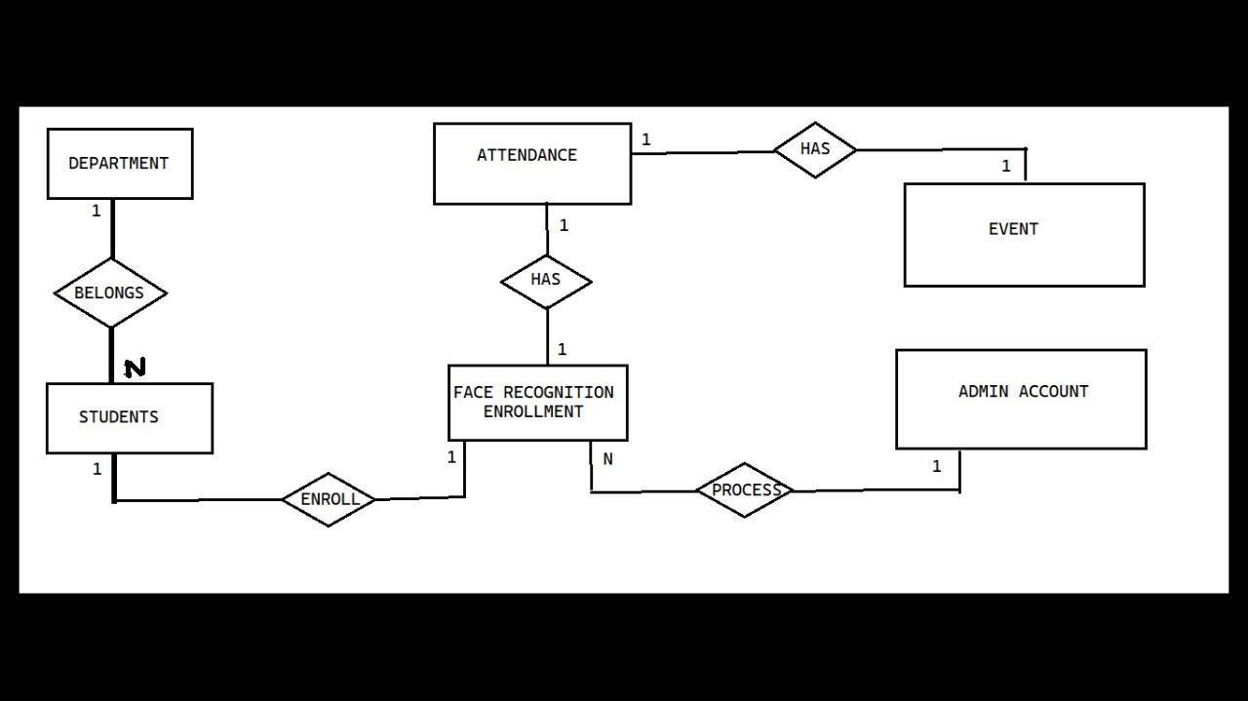
E-R Diagram

Slide 12
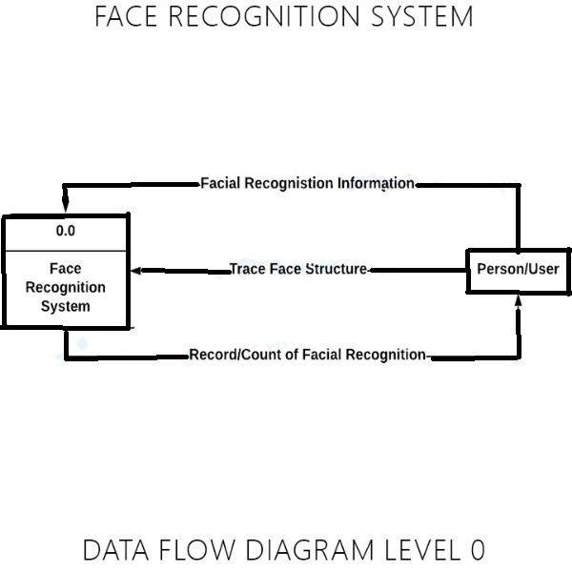
Data Flow Diagram
Level 0:

Slide 13
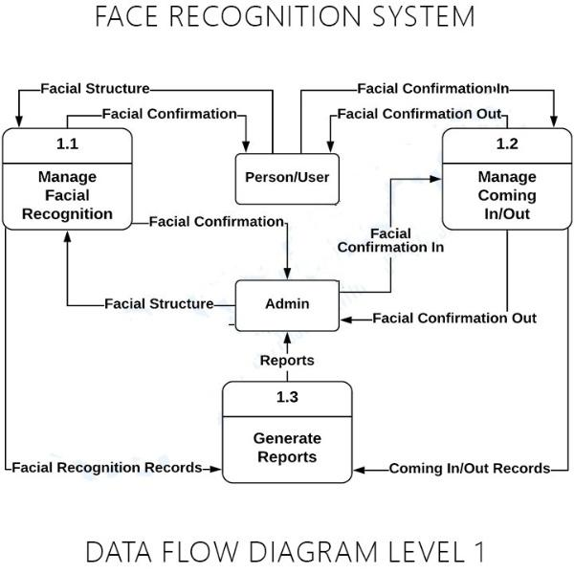
Level-1

Slide 14
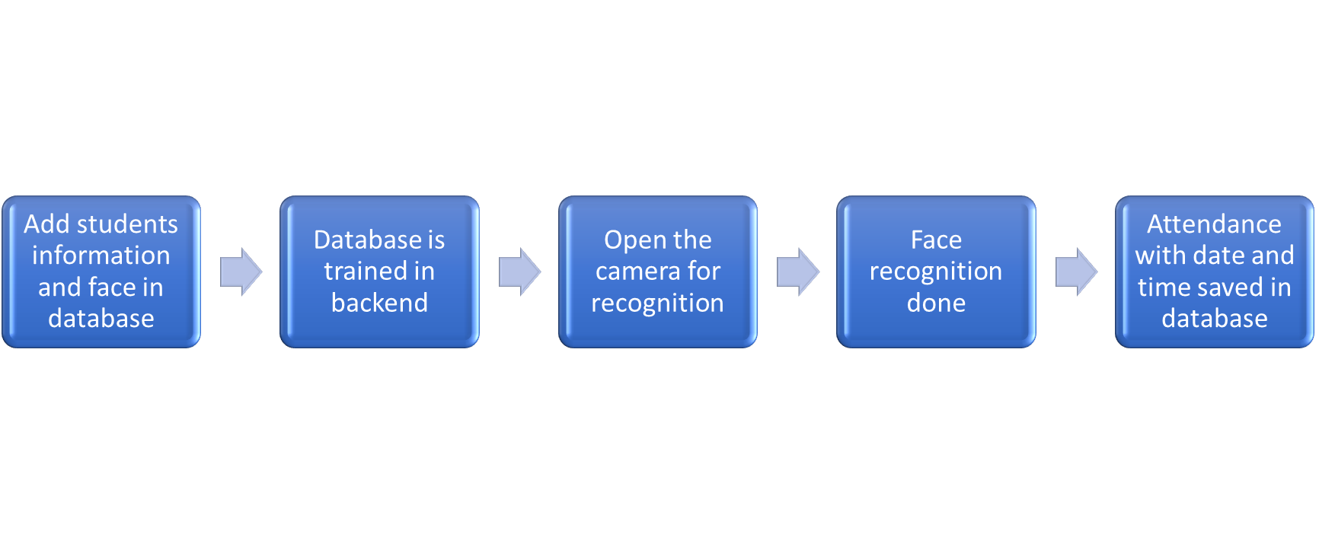
Project Work Flow Diagram

Slide 15
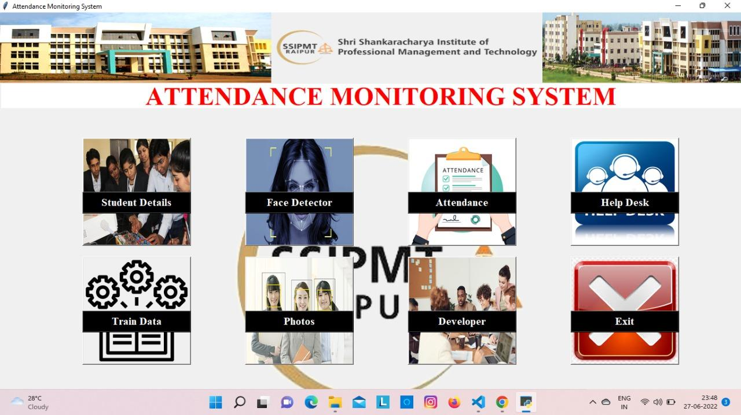
Snapshots with Description

Slide 16
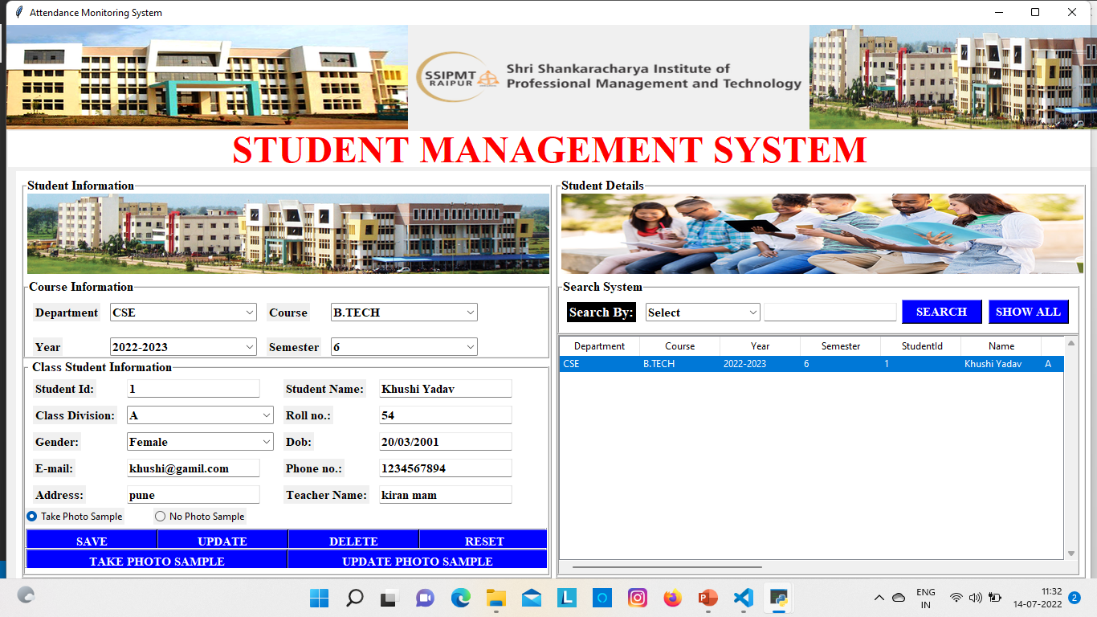

Slide 17
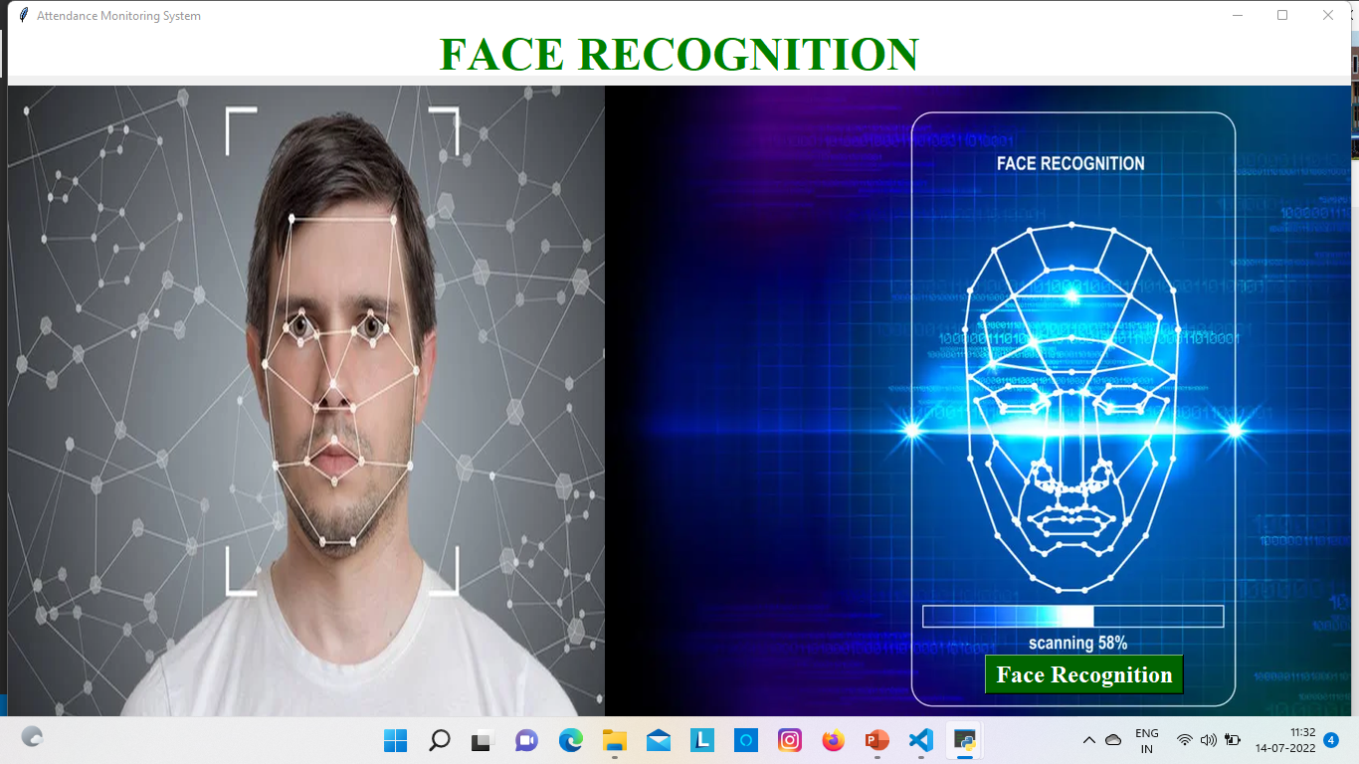

Slide 18
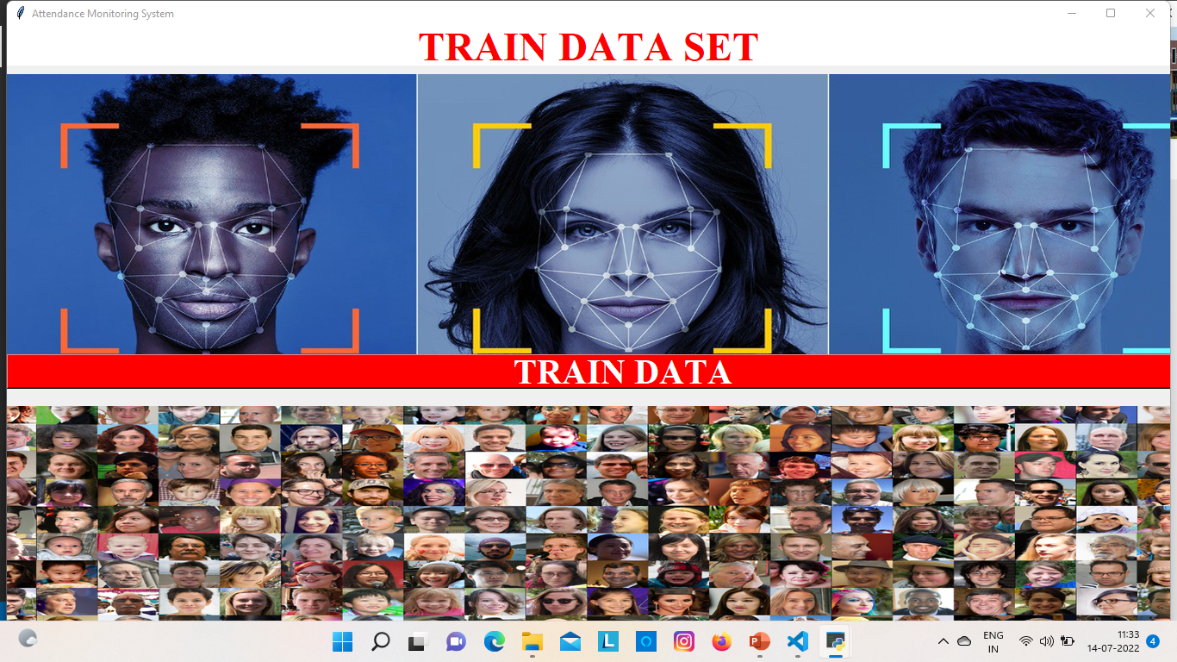

Slide 19
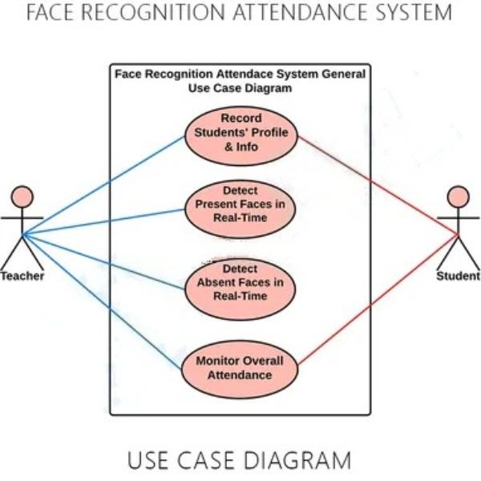
Use-Case Diagram

Slide 20
Result & Conclusion
The face recognition based attendance system is an efficient method of automatic attendance in the classroom which would replace the traditional method.
An automatic attendance has many advantages, most of the existing systems are time consuming, our system seeks to solve these issues by using face recognition in the process to save time and labor.

Slide 21


